Slide 1


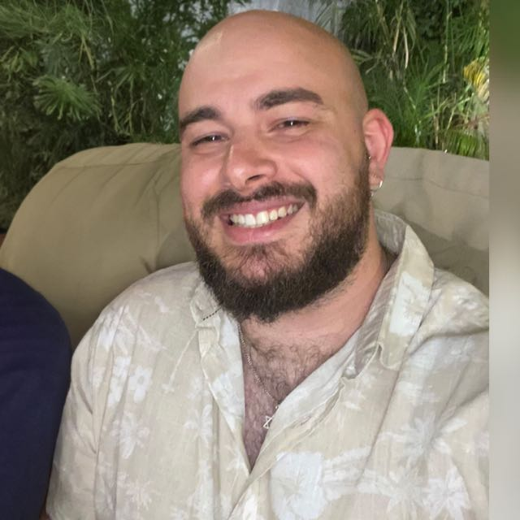


Sonic Cipher
24-1-R-2
Michael Ioffe
315388900
Shay Zak
312330749
Supervisor
Alex Keselman
1

Slide 2

Introduction
Overcoming language barriers is crucial.
Developing a real-time voice-to-text translation web app.
Using Google Speech-to-Text, Google Translate, and ChatGPT APIs.
Enhancing communication and inclusivity.
2

Slide 3

The Projects Goal
Objective:
Bridge language barriers with real-time translation
Provide seamless communication solutions
Ensure accessibility on all platforms
Focus:
Utilize Google's Speech-to-Text and Translate APIs
Incorporate OpenAI's ChatGPT
Implement peer-to-peer and asymmetric encryption
The Results:
Enhanced user satisfaction
Secure communication
Improved global communication
3
Notes:
לעשות יותר קצר

Slide 4


Need For The Project
Current Issues with Translation Tools:
Lack real-time accuracy, context sensitivity, and privacy.
Our Solution:
Secure, real-time voice translation.
Uses advanced APIs.
Provides seamless user experience.
4

Slide 5

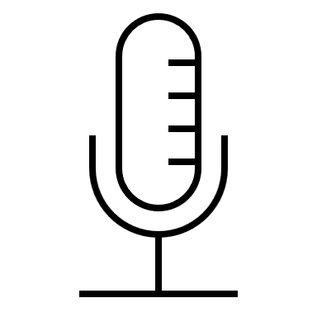
Our Solution
Real-time Translation
Advanced APIs
Speech Capture
Seamless Communication
5
Notes:
/////

Slide 6
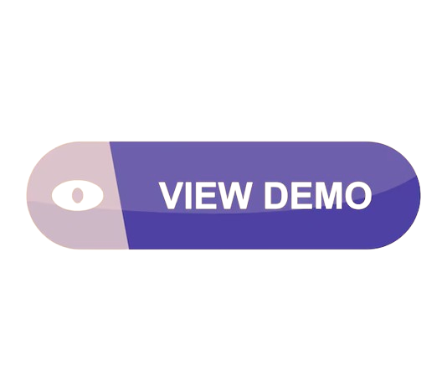
Live Demonstration
Between Goole Translate API and OpenAI API
6

Slide 7
The Innovation In Our Solution
Voice Translation
Accurate Translations
User-friendly Interface
Multi-language Support
7

Slide 8
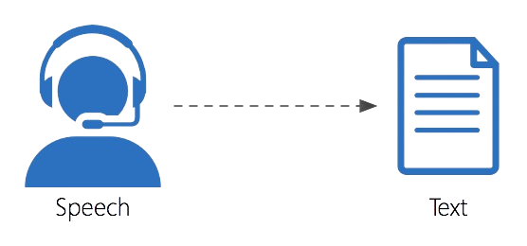
Google Speech-To-Text API
Supports 120+ languages.
Real-time transcription.
High accuracy.
Handles noise.
Customizable vocabulary.
8

Slide 9
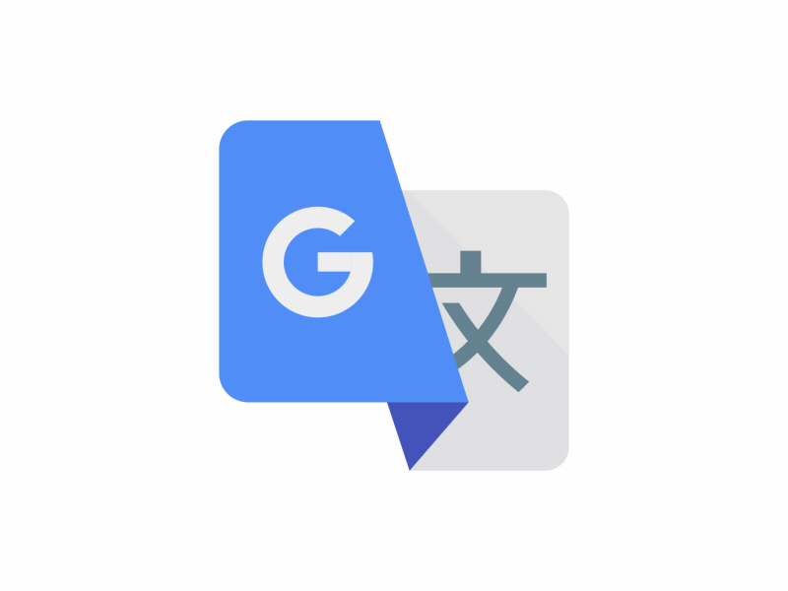
Google Translate API
Translates text in 100+ languages.
Accurate, real-time translation.
Auto language detection.
Integrates with Google services.
Text and speech translation.
9

Slide 10
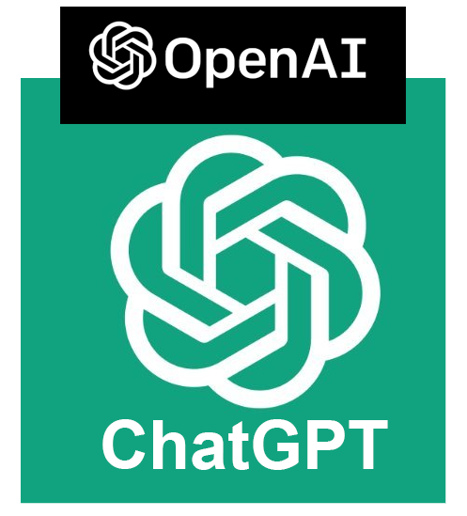
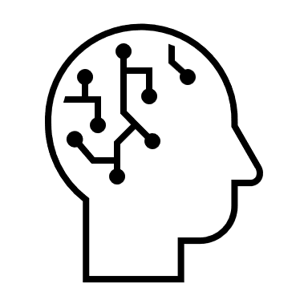
OpenAI ChatGPT API
Enhances context understanding.
Provides nuanced translations.
Supports multiple languages.
Generates human-like text.
Improves conversational accuracy.
Adapts to user input.
10

Slide 11
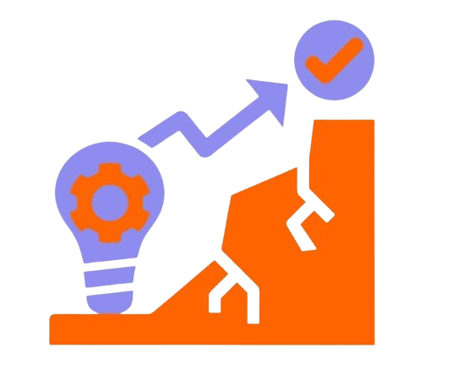

Challenges
Combining multiple APIs.
Minimizing latency.
Ensuring precise translations.
Managing background noise.
11

Slide 12
Flow-Voice Capture and Translation Flow
01
03
05
Select Languages
Voice Input
(Start Recording)
Display Transcribed Text
02
04
06
Speech-to-Text Conversion
Translate Text
Choose Translation Method
12

Slide 13
Free- Google Translate API
Flow-Text Translation
01
03
05
HTTP request to Google Translate API
Play the translation
Display Translation
04
02
Google Text-to-Speech API
Process Translation
Premium- OpenAI ChatGPT API
01
03
05
HTTP request to OpenAI API
Translation Displayed
Receive users Specification
04
06
02
Receive captured text
Process Translation
Play The translation
13

Slide 14
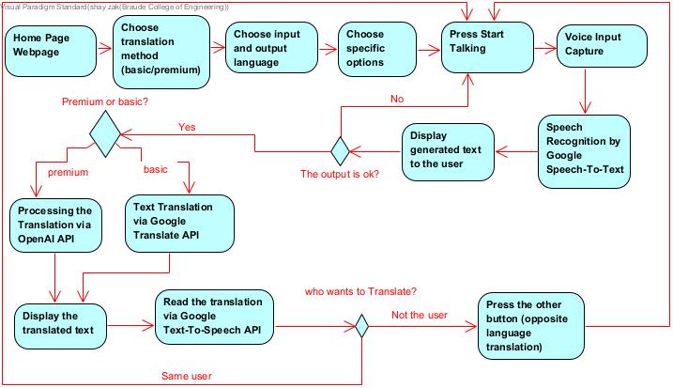
Flow Diagram
14

Slide 15
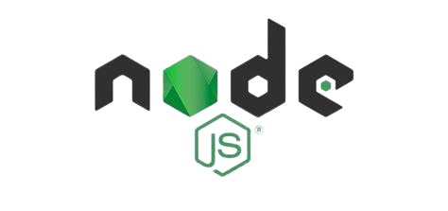
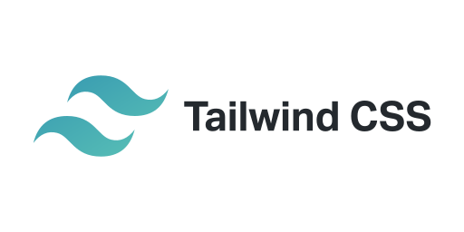

Implementation
Node.JS
Preact
Backend
Frontend
15

Slide 16
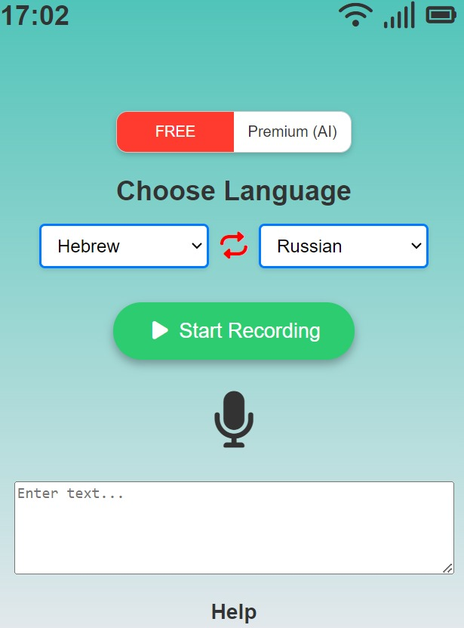
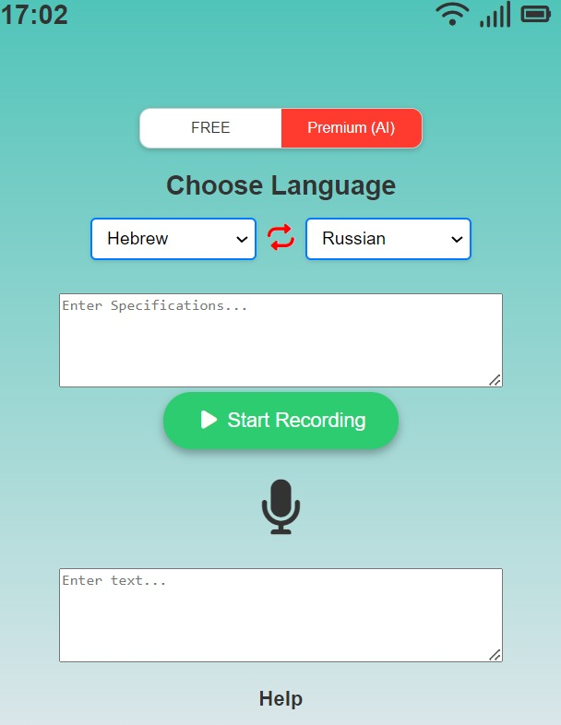
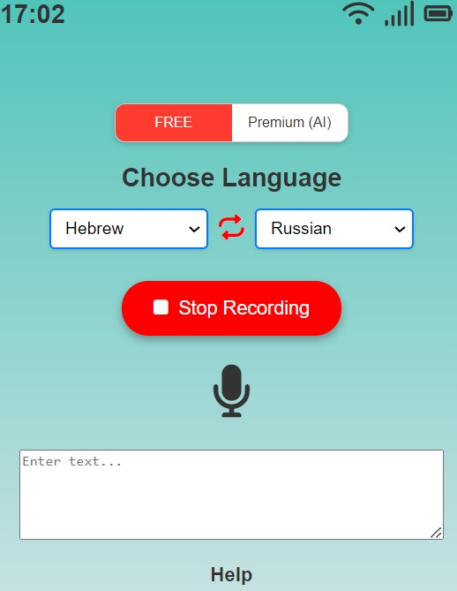
Interface
Free
Premium
16

Slide 17
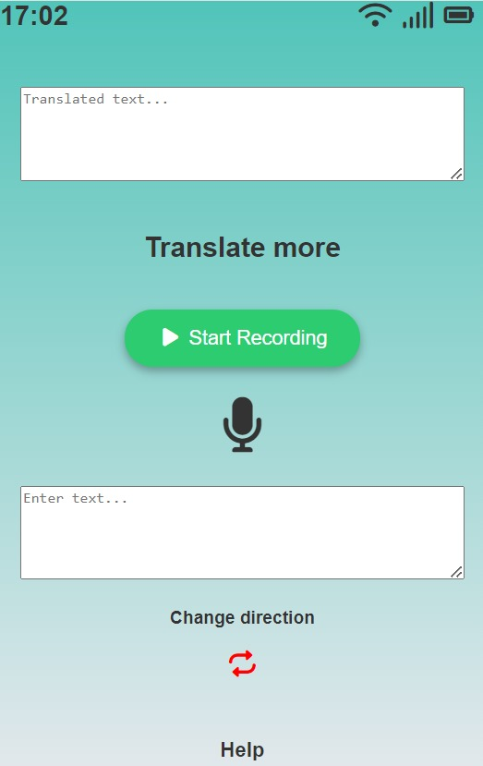


Interface
(after translation)
17

Slide 18

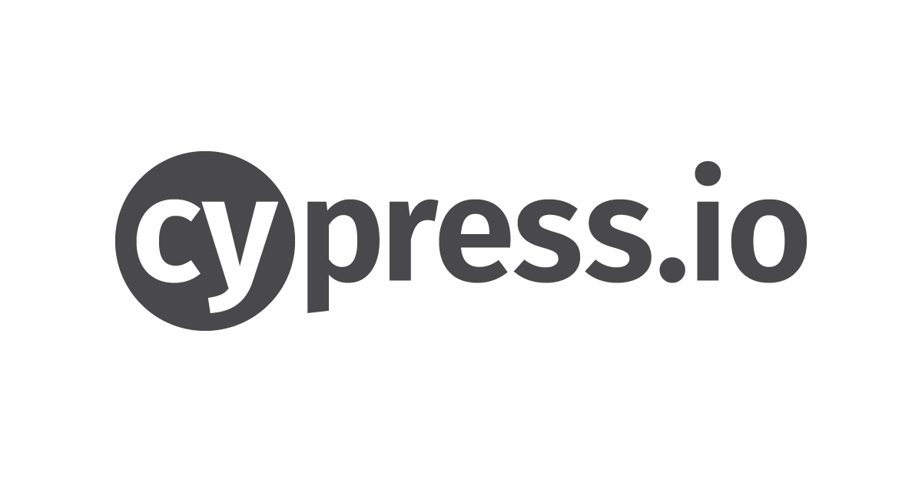
Verification And Testing
Frontend Testing
BackEnd Testing
Speech-to-text
Translation accuracy
Text-to-speech
Device compatibility
Browser compatibility
Response time
Latency
API call speed
Heavy user load
Testing Frameworks
18

Slide 19
Thank you for Listening
Questions?
19
Notes:
אליאב

